Slide 1
Provisional Licensed Professional Counselor (P-LPC)
Application requirements
Complete 60 graduate semester hour (90 quarter hour) master’s degree, which includes the 12 course content areas
Pass the National Counselor Exam
Does not require Board approval…even though the NBCC site indicates differently.
Notes:
SS/VW
Cannot piecemeal degree
NCE can be taken prior to degree confirmation

Slide 2
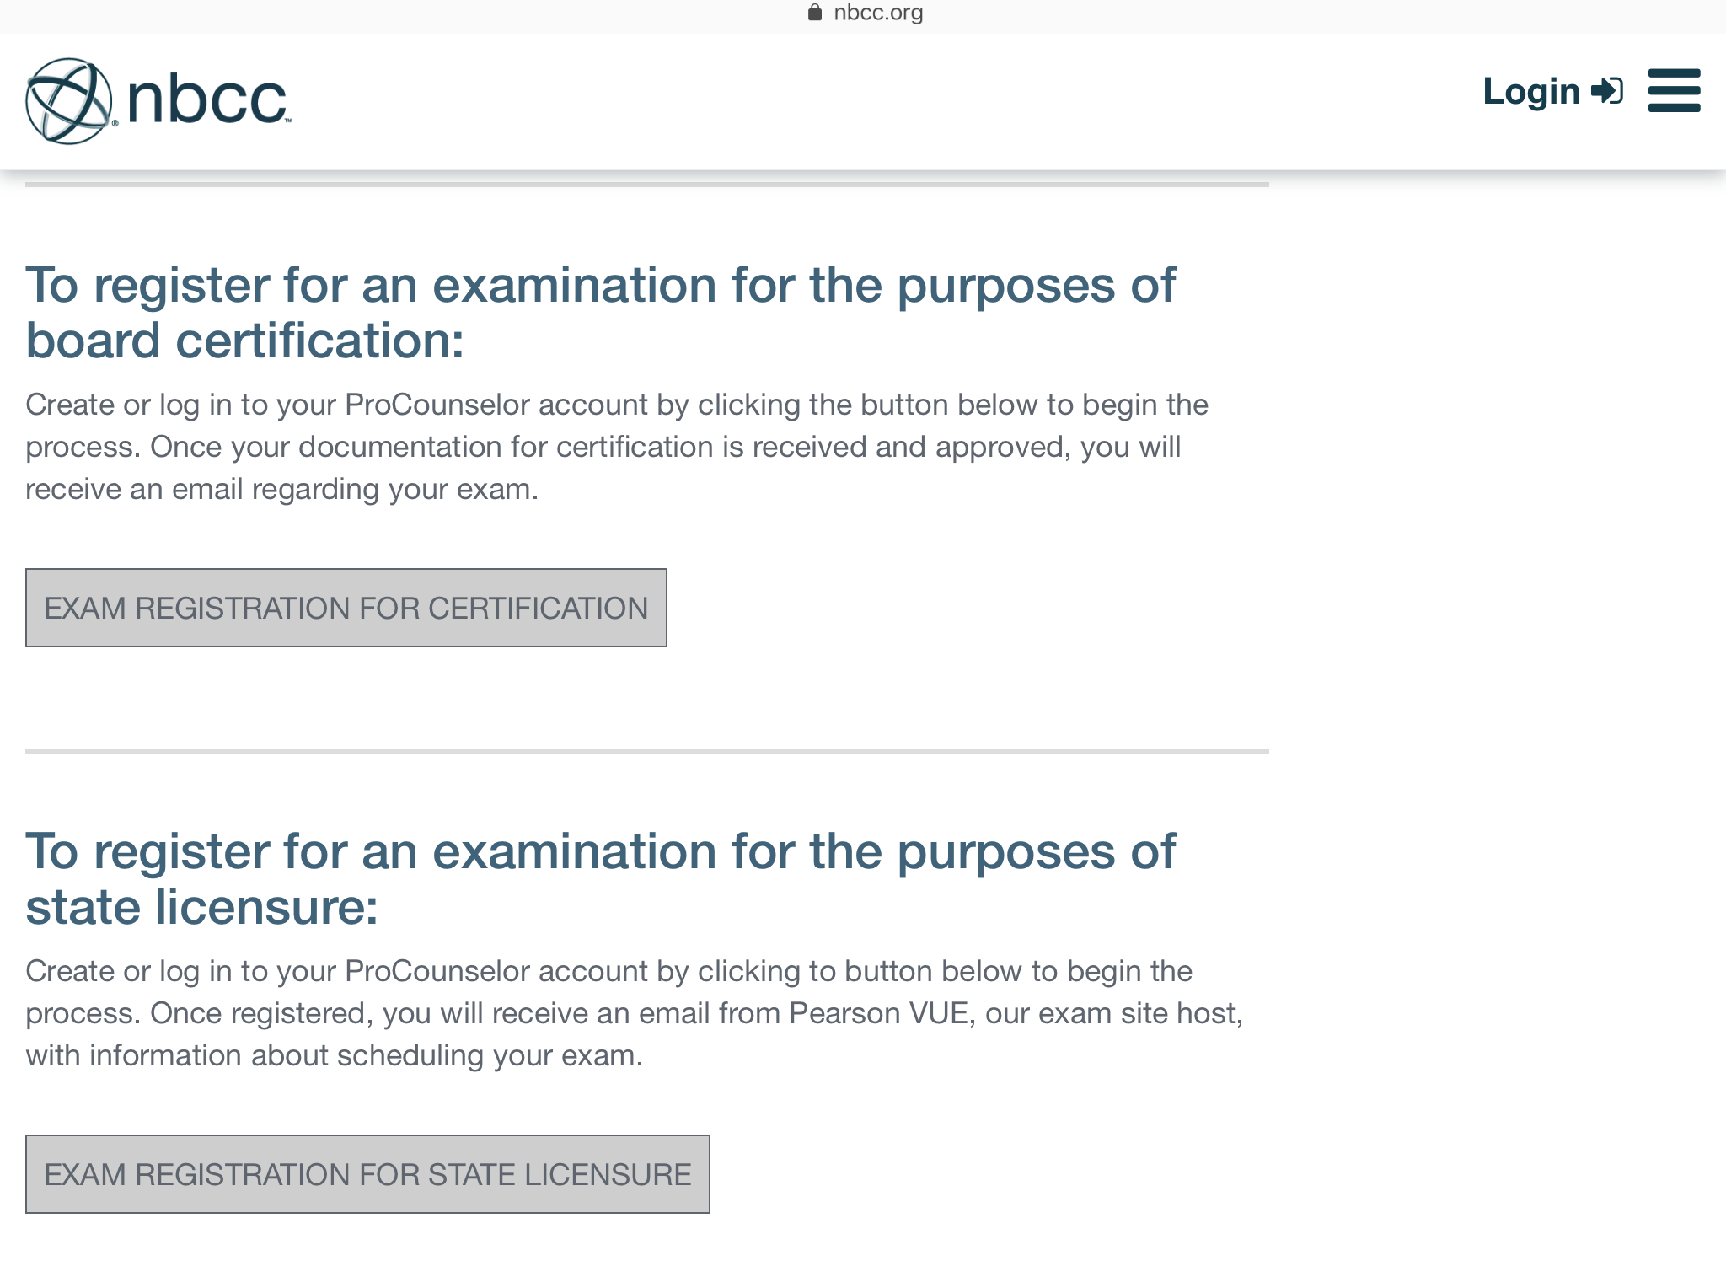
Do not apply for board certification
Make sure to apply for state licensure
Notes:
SS/VW
Cannot piecemeal degree
NCE can be taken prior to degree confirmation

Slide 3
Provisional Licensed Professional Counselor (P-LPC)
Application requirements
Submit Declaration of Practice indicating clinical setting
Submit supervision contract
Complete Application and Pay Application Fee
Notes:
SS/VW

Slide 4
Supervised Experience Requirements
The new Rules and Regulations - someone with a P-LPC can practice in a private practice setting (a “non-governed by” setting) with an LPC onsite.
Prior Rules and Regulations required an individual with an LPC-S onsite.
Notes:
KS/LE

Slide 5
Supervised Experience Requirements
The MS Board will only approve clinical sites in Mississippi.
A Mississippi LPC-S cannot practice (supervise hours) in another state…without being appropriately licensed in that state.
Notes:
KS/LE

Slide 6
Supervised Experience Requirements
What if I live in a “border town”?
Example: What if I want to practice in Waveland, MS and Slidell, LA.
You must follow the Laws and Rules and Regulations for Mississippi and Louisiana.
If verified by the LA Board, The MS Board would consider accepting the hours accrued in LA for a MS LPC.
Notes:
KS/LE

Slide 7
Declaration of Practice
Basically, informed consent for site setting for supervisee
Individuals with a P-LPC practicing in a non-governed by setting (e.g., private practice, etc.) are encouraged to have clients sign this declaration as part of his/her Informed Consent process.
Notes:
SS/VW
DoP required regardless of setting of practice
Added by RS - For non-governed by settings, location/address and LPC onsite while P-LPC is providing services must be clearly documented.

Slide 8
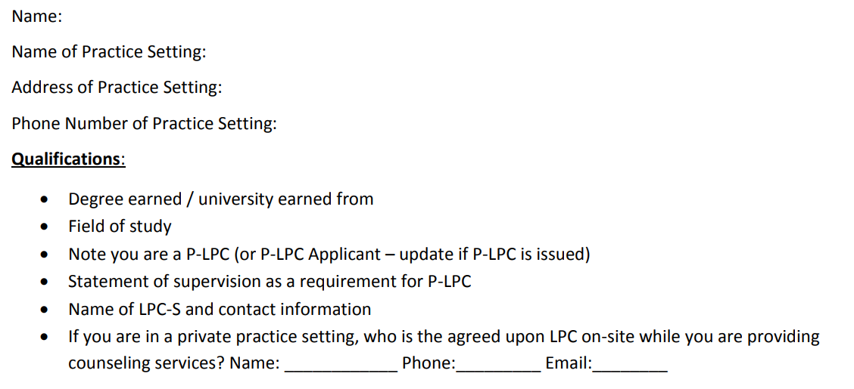
Declaration of Practice
Declaration of Practice

Slide 9
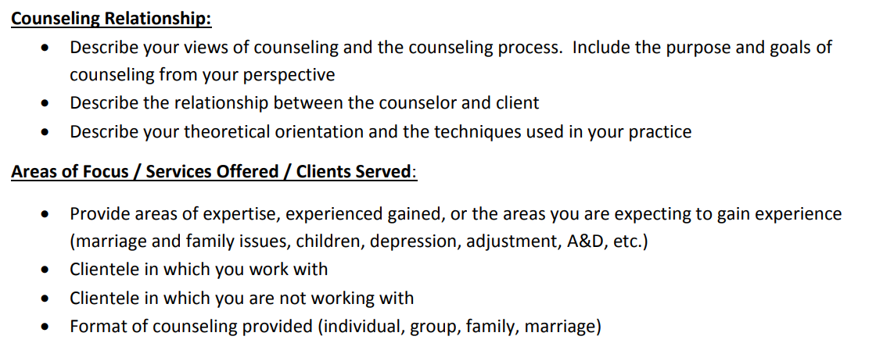
Declaration of Practice

Slide 10
Declaration of Practice

Slide 11
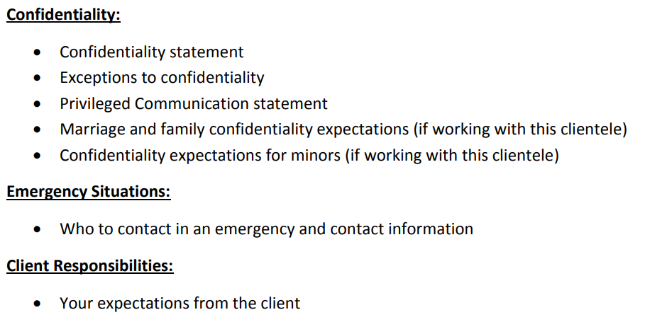
Declaration of Practice

Slide 12
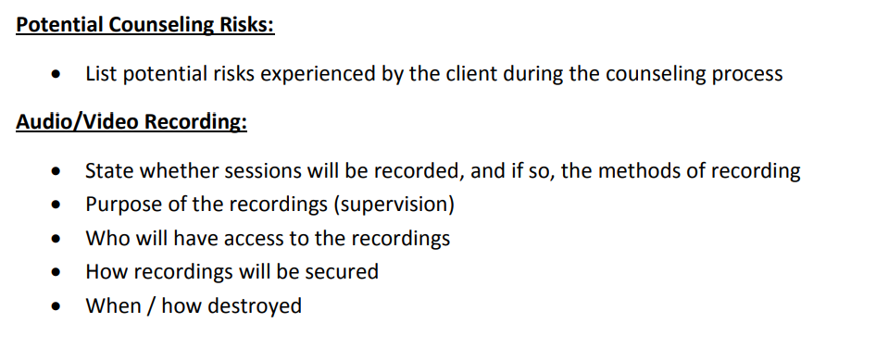
Declaration of Practice

Slide 13
Supervised Experience requirements for the LPC
LPC requirements (Beginning July 1, 2018)
3,000 post-masters
1,200 direct services
100 supervision
Notes:
KS/LE
Applicants after July 1, 2018 will not longer be able to count internship and practicum hours

Slide 14
Supervision Contract Requirements
Register the supervision agreement online through the Board’s web portal.
Notes:
KS/LE

Slide 15
Supervision Contract
Upload the signed supervision contract to the Board’s portal
Brief philosophy of supervision (1-2 paragraphs)
Expectations of supervisee
Supervisor and supervisee responsibilities
Back up LPC-S for when supervisor is out of pocket
Terms of supervision (including fees)
Signatures of supervisor and supervisee
Notes:
KS/LE

Slide 16
Supervision by Distance Professional Services
Supervision can be provided by way of Distance Professional Services.
Complete the Board Certified TeleMental Health (BC-TMH) credential through CCE.
File the BC-TMH credential with the Board.
Conferencing/supervision is only allowed via secure synchronous video.
The Supervision Agreement submitted to the Board must explain the use and limits of distance supervision.
Notes:
KS/LE
Any person that provides counseling or supervision services through the means of Distance Professional Services must be licensed both in the location where services are provided by the professional as well as in the location of the recipient of the services

Slide 17
Declaration of Practice
Supervisee will upload to Board’s web portal.
Supervisor will ‘concur’.
Notes:
SS/VW

Slide 18
Supervision Documentation
Progress Note
Hours Log
Form B
Update upon LPC-S renewal
Notes:
KS/LE
Applicants after July 1, 2018 will not longer be able to count internship and practicum hours

Slide 19
Supervision Contract Requirements
P-LPCs must report supervised hours using the online log portal provided through the LPC Board’s website.
Notes:
KS/LE

Slide 20
LPC-S Documents Supervised Experience

Slide 21
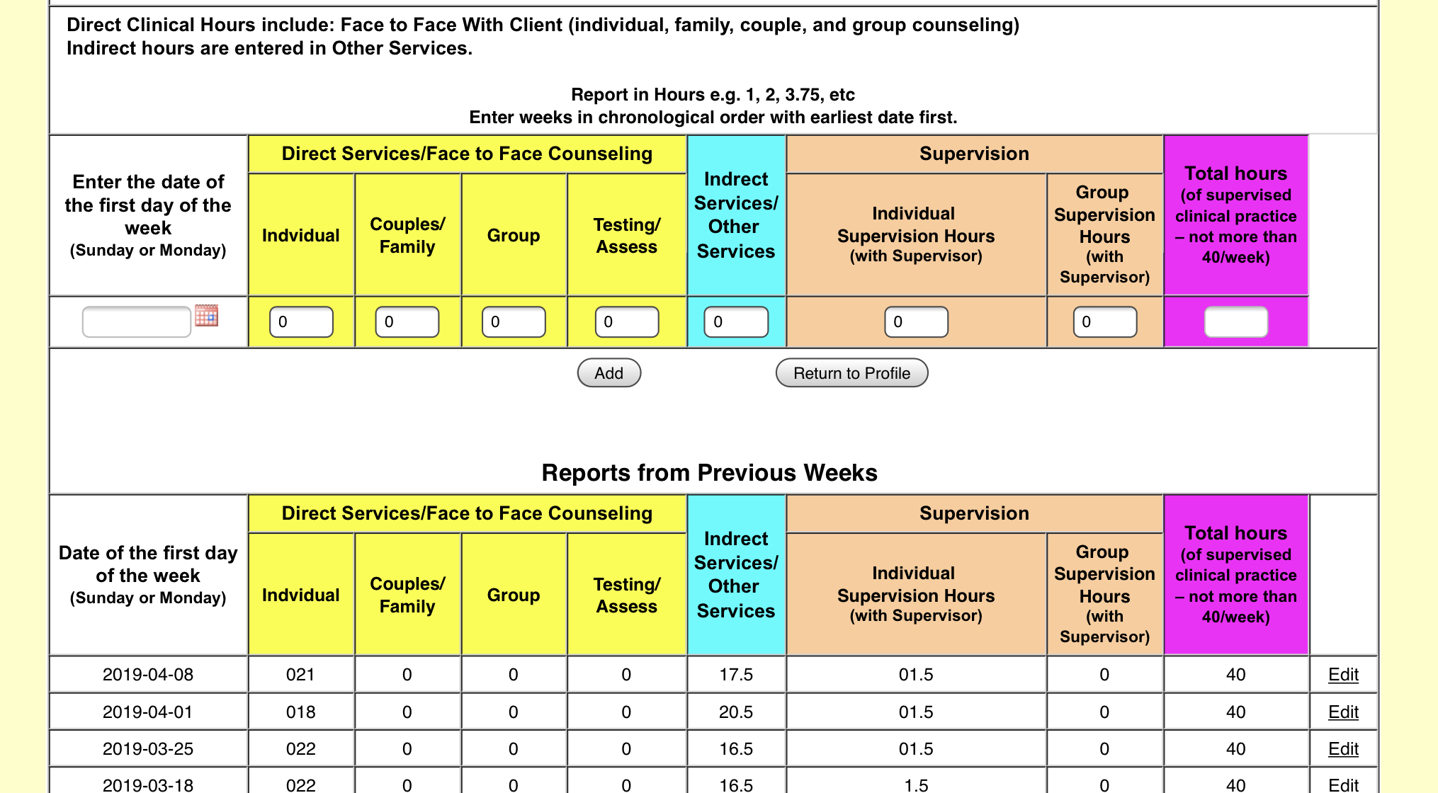
Documenting Supervised Experience
Complete during supervision
OR
Verify

Slide 22
Supervision Documentation by the LPC-S
Prepare Form B
Agreement Complete
Verify the completed hours from the supervision reporting log and enter in the blank fields, then click on the “Update” button
LPC-S will then be taken to the Form B to complete
Form B is automatically submitted was LPC-S “saves form”
Notes:
Applicants after July 1, 2018 will no longer be able to count internship and practicum hours

Slide 23
General Registration Tab

Slide 24
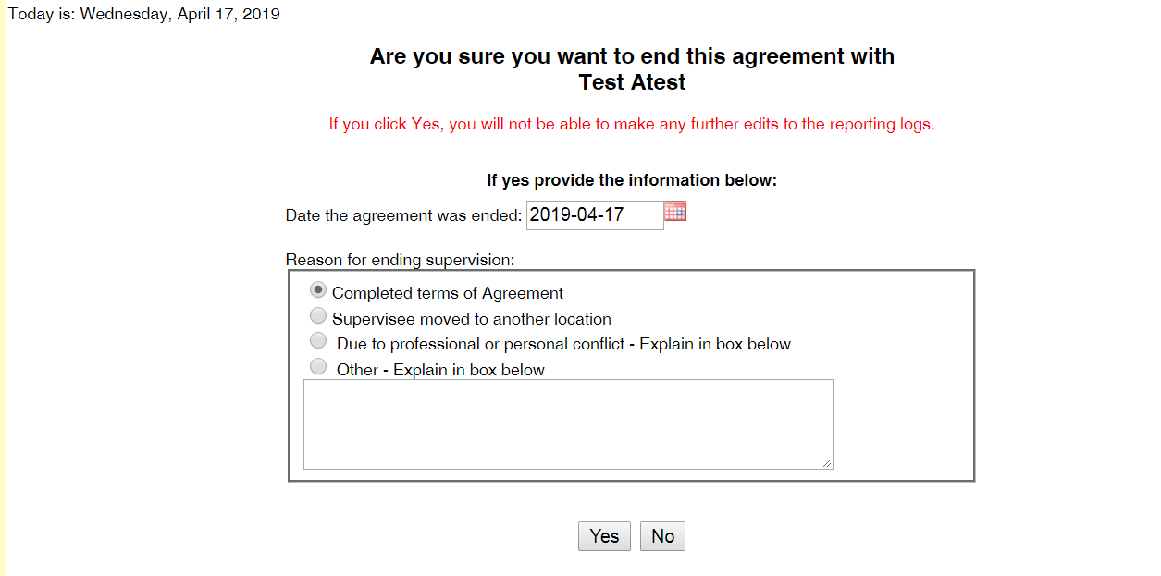

Slide 25
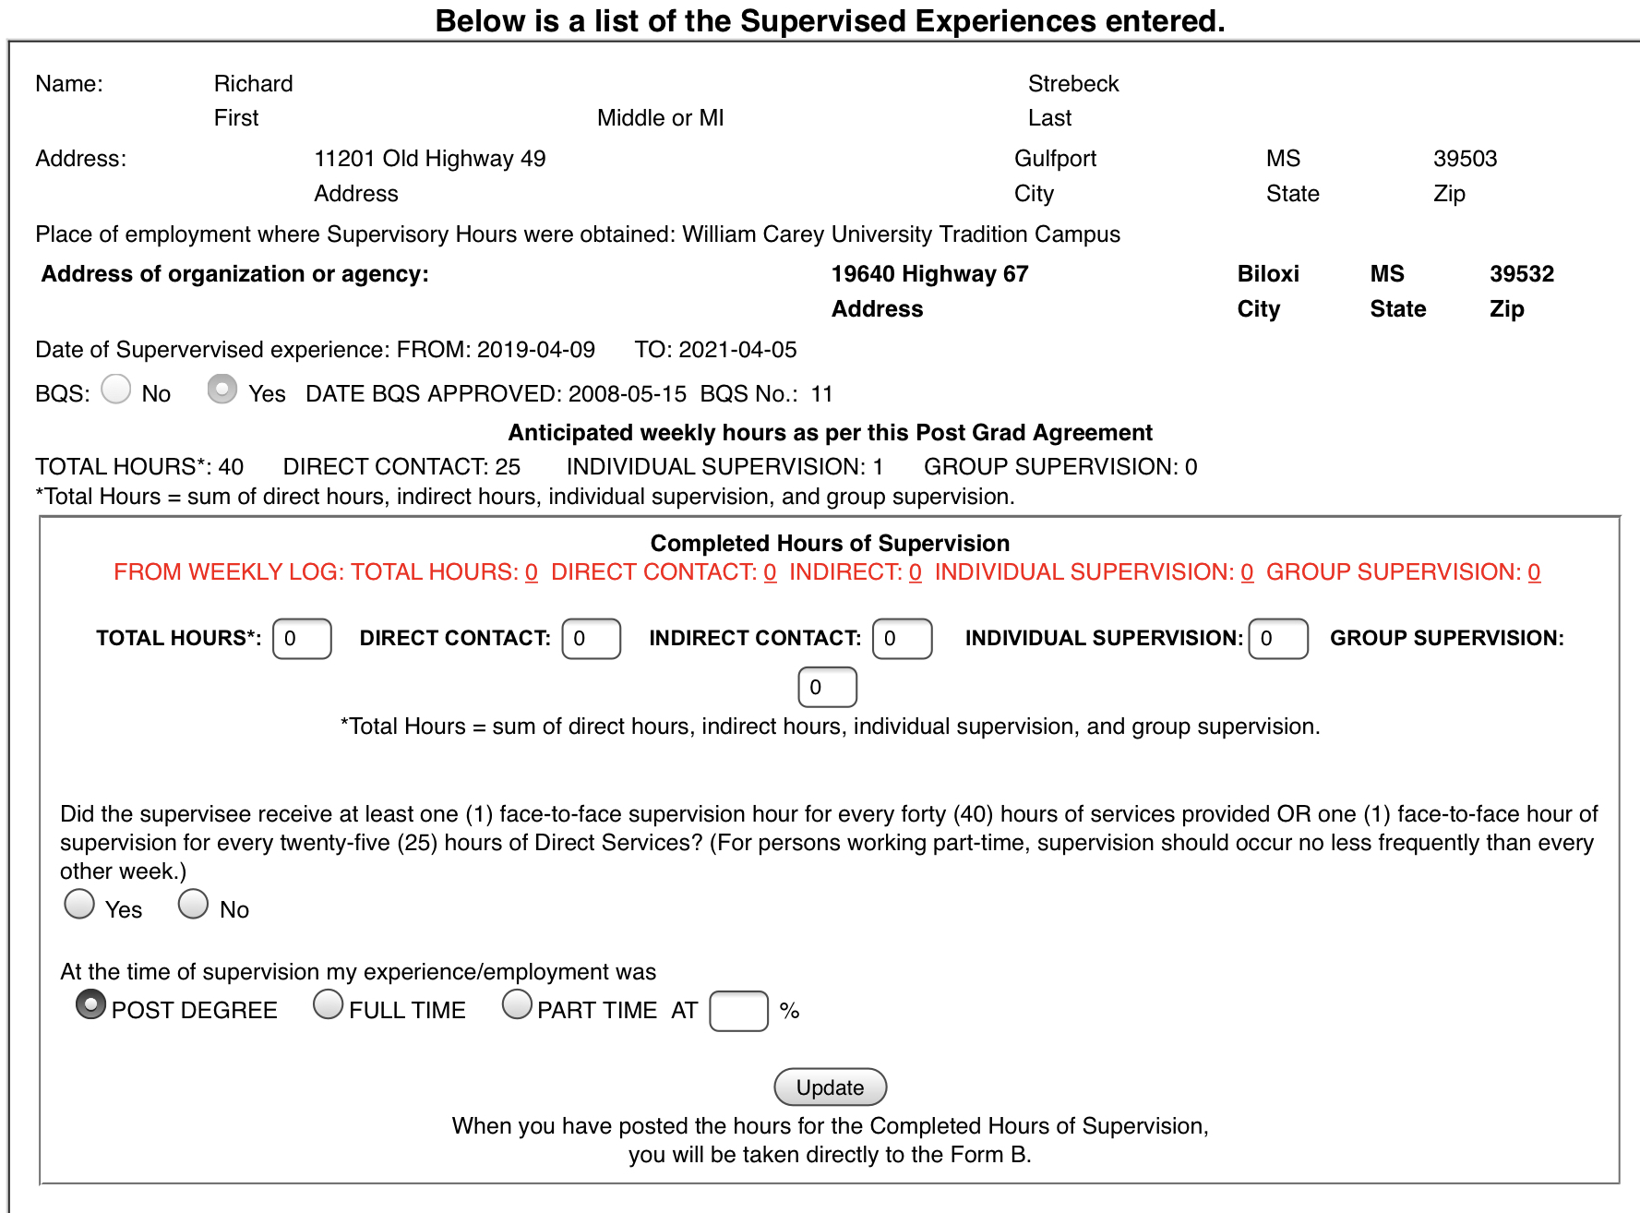
Verify/enter hours
Click update

Slide 26
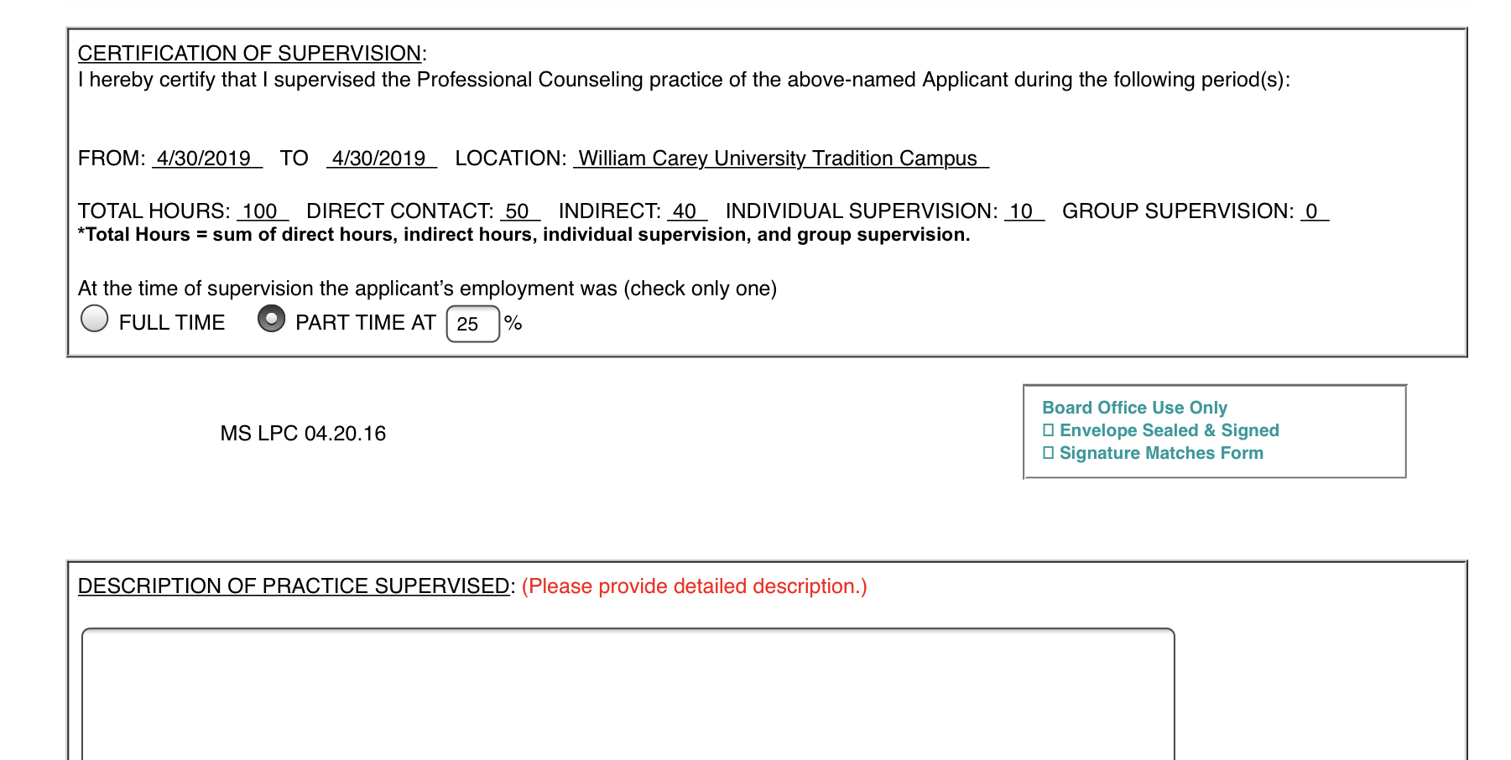
Complete Description of Practice

Slide 27
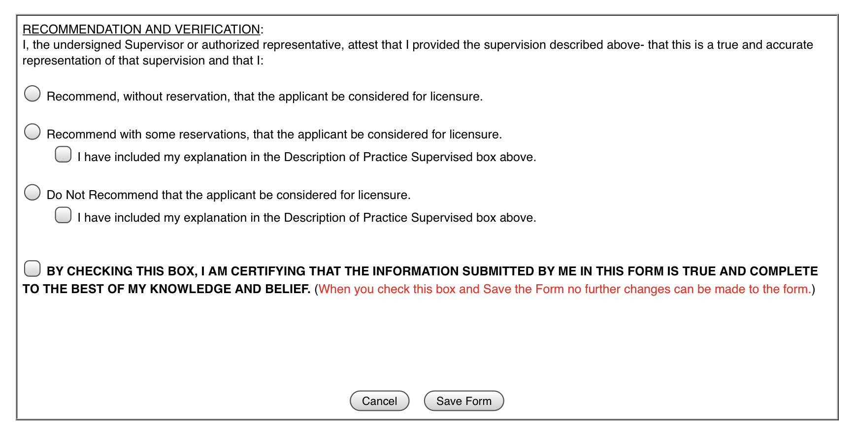
Make recommendation

